Slide 1
#05 Windows Control, Events and Event Handlers
Notes:
Give an explanation for windows control, events and event handlers
Relevant theoretical decisions
What are windows controls?
What is an event and what does it mean?
What is an event handler, how it works and what it contains?

Slide 2
Windows Control

Slide 3
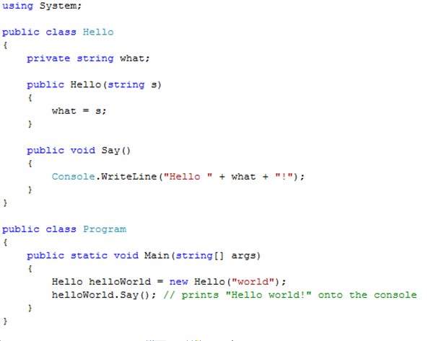
Windows Control example

Slide 4
Events and Event Handlers
What is an event
What is an event handler
Notes:
An event, in event-driven programming (like Windows!), is when something happens—
often as a result of user action, but at times as a result of a change in system
state or a result of a message begin received from outside the system (e.g., via the
Internet).
An event is an object that represents some activity to which we may want to respond
Events often correspond to user actions, but not always

Slide 5
Events example
namespace BlackJackGUI
{
public partial class BlackJackWindow : Form
{
public BlackJackWindow()
{
InitializeComponent();
textBoxGame.AppendText("♠ ♣ ♥ ♦ BlackJack:\n");
}
private void SaveLog_Click(object sender, EventArgs e)
{
File.Copy(@"../../BlackJack.tmp", @"../../BlackJackLog.txt",true);
}
}
Notes:
The SaveLog_Click event handler is listening for a mouse click on the Save Log button, which generates a SaveLog_Click event. The event handler then saves what is in the BlackJack.tmp file to BlackJackLog.txt file.

Slide 6
Custom Events

